Slide 1
Player Efficiency Rankings
File created on: 7/26/2026 4:50:30 AM

Slide 2
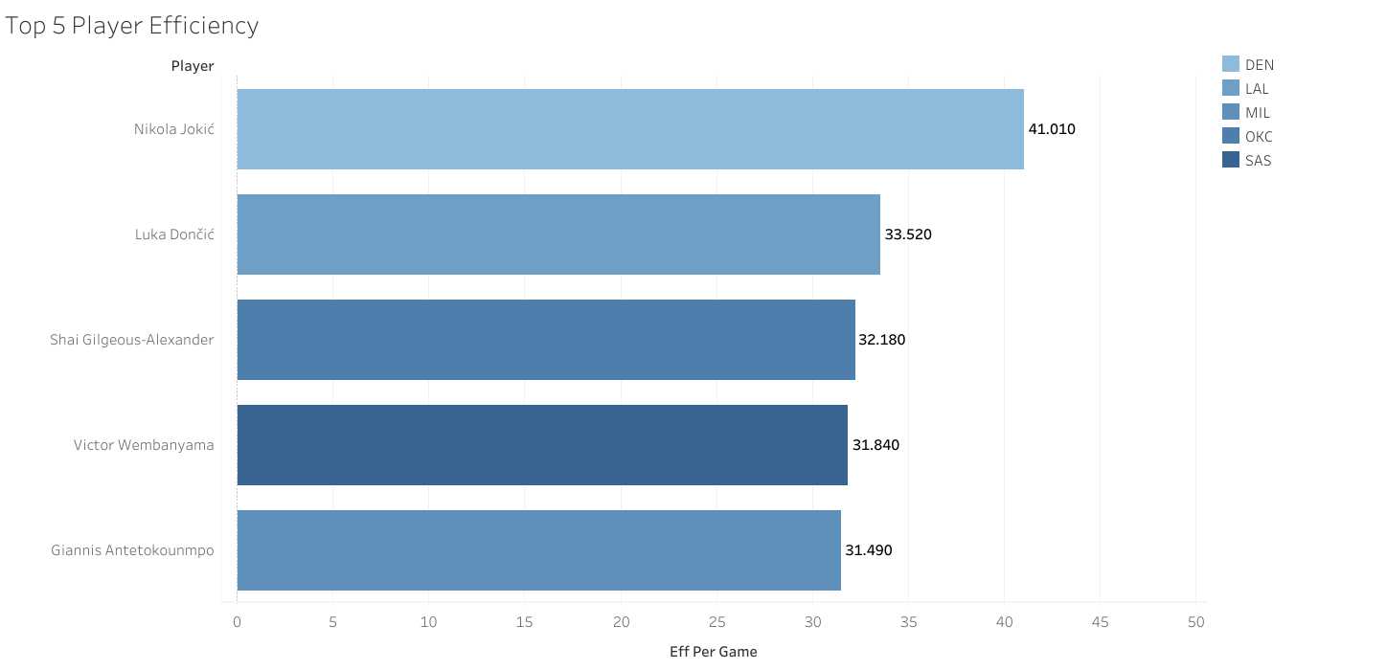

Slide 3
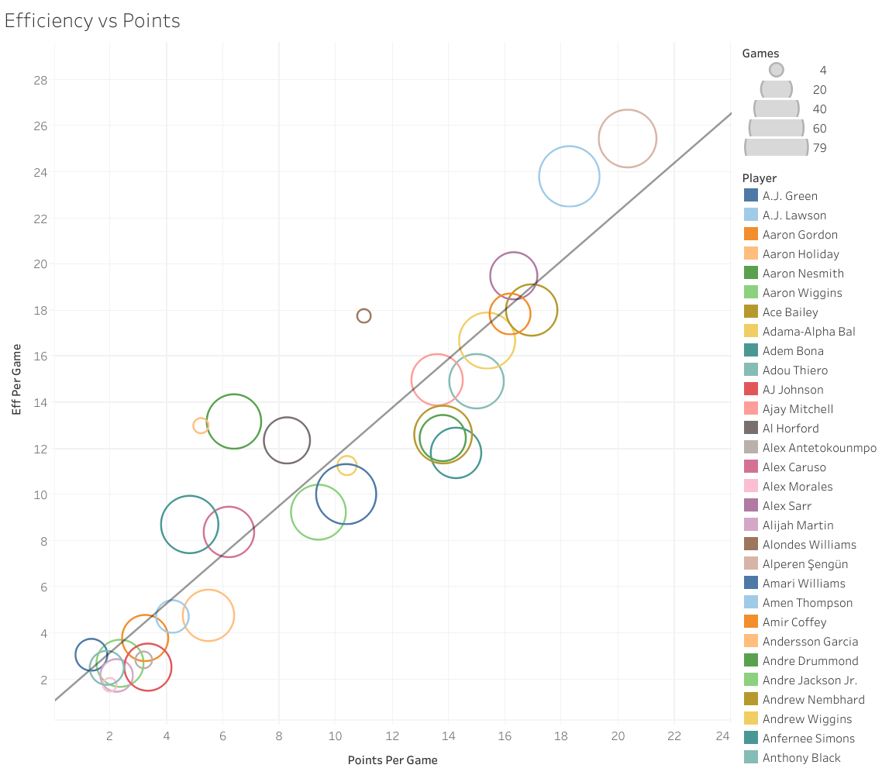

Slide 5
